Slide 1
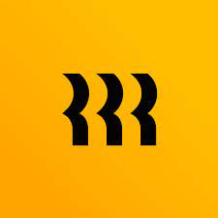

Rippling
Nicholas Catani
ISM-6331 Information Systems Security

Slide 2
Outline
Directory as a service
Cost analysis
Competitors
Installation
Recommendations

Slide 3

daas
It is an all-in-one employee management software that links human resources, and IT management, all under one roof. From device, and app management to payroll, benefits, talent, and employee management.
FROM 2 TO MORE THAN 2000 USERS

Slide 4
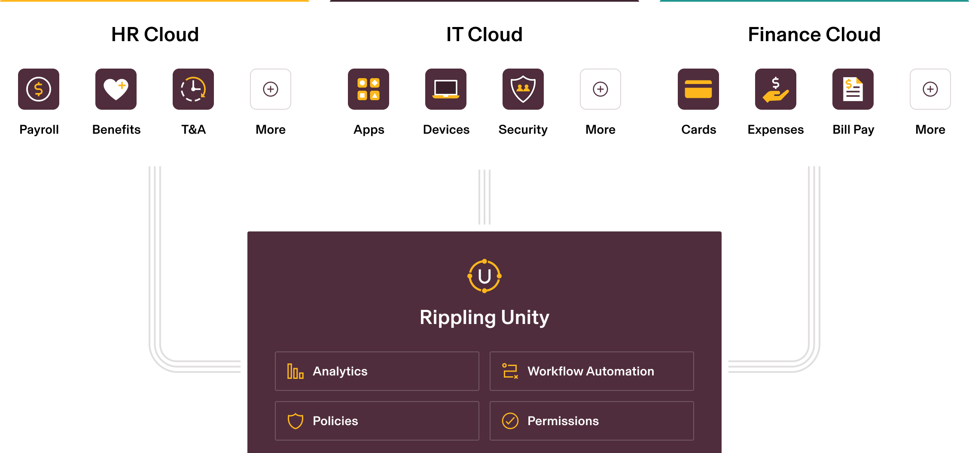

Slide 5

Cost analysis
[ The company offers services a-la-carte. Deals are not standardized but skirted based on the company’s needs. ]

Slide 6
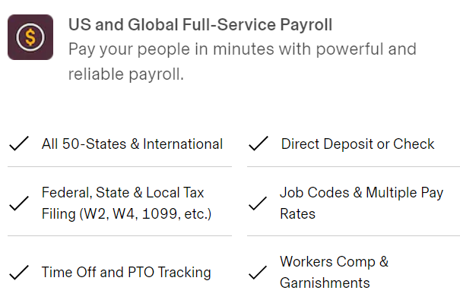
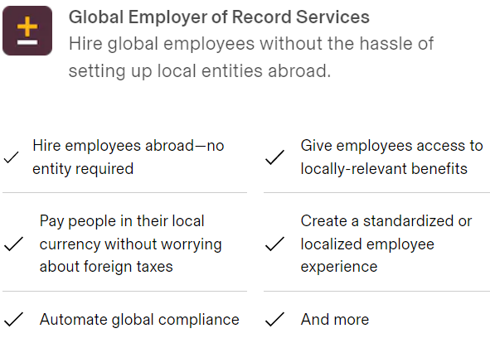
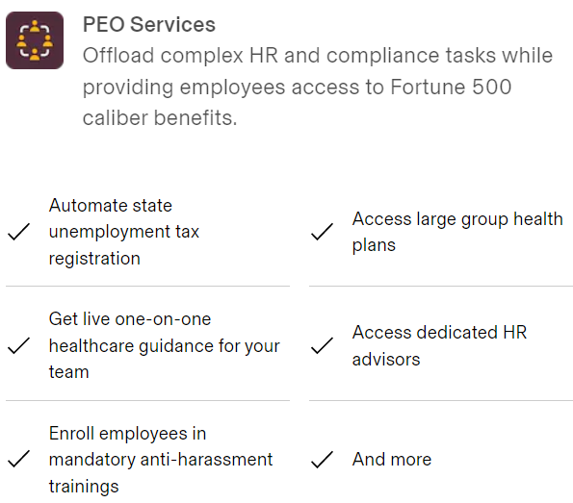
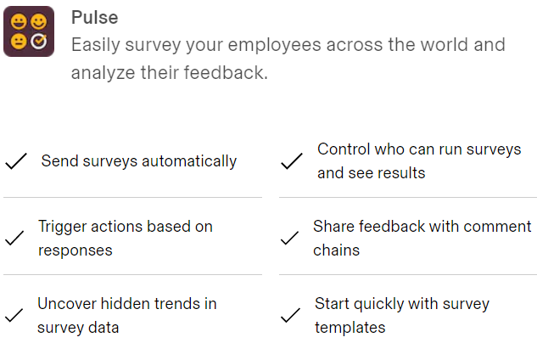
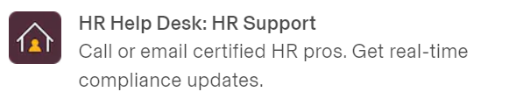
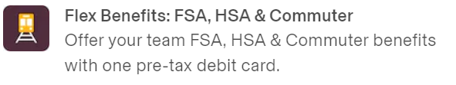

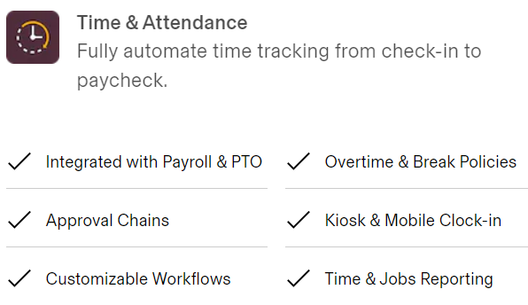
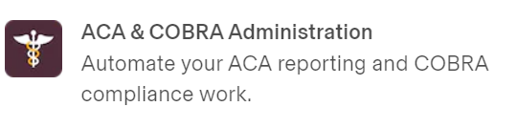
HR cloud

Slide 7
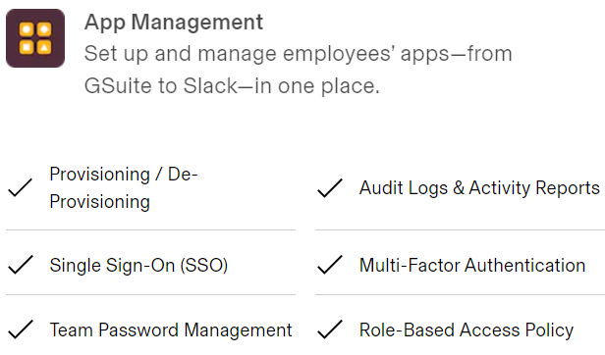
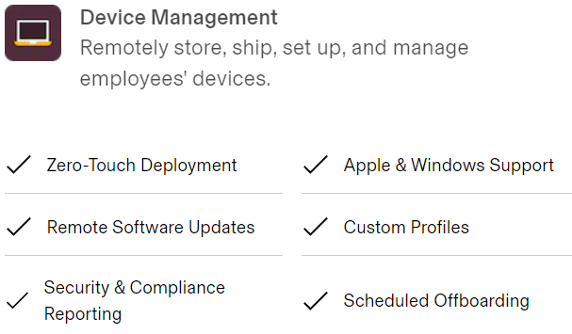
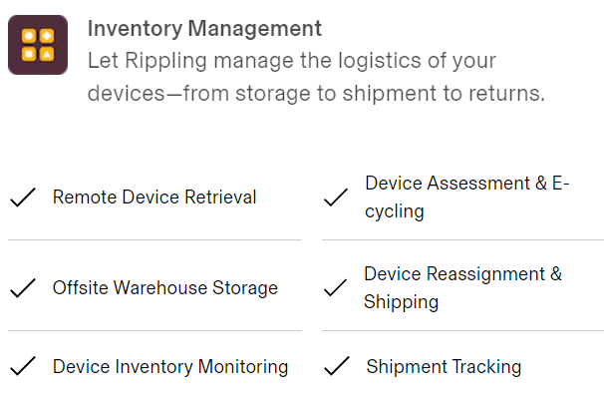
It cloud

Slide 8
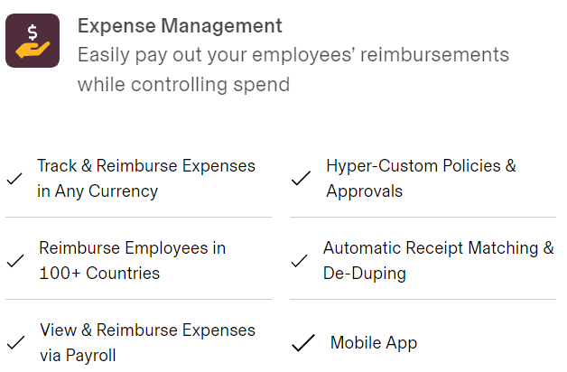
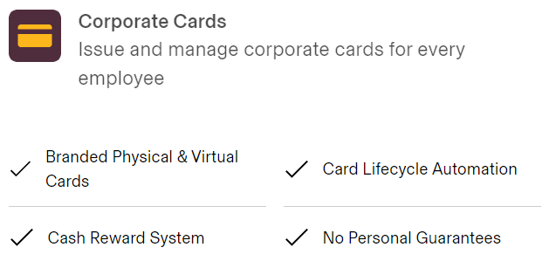

Finance cloud

Slide 9

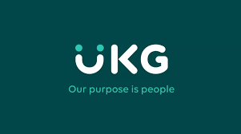
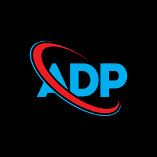
Competitors
BambooHR
Easier to do business with
Easier to set up
X More expensive
ADP
X More expensive
X Slower to reach return on investment
UKG pro
X More expensive
X Slower to reach return on investment

Slide 10
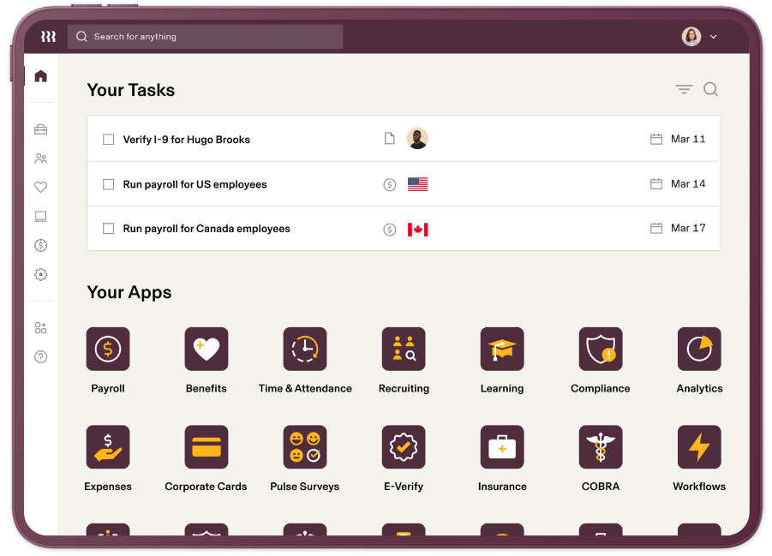
Installation
The software cannot be tried out beforehand. Users must sit through a demo and reach to their team before learning more about its functionalities

Slide 11
Recommendations
Regardless the business size, Rippling could be a solid solution.
Best for companies with (75 or more employees) or need a full solution in a single software to manage the entire HR function.
Cost-wise, a company may find better solutions if it’s looking for specific functionality.

